Slide 1
<Project Logo>
Unified Experience Tracker
23/05/2023
PMO-TPL-013_v.1.0

Slide 2
01 UI Designs
02 Brandscopic API Integration
03 Questions

Slide 3
1
UI Designs

Slide 4
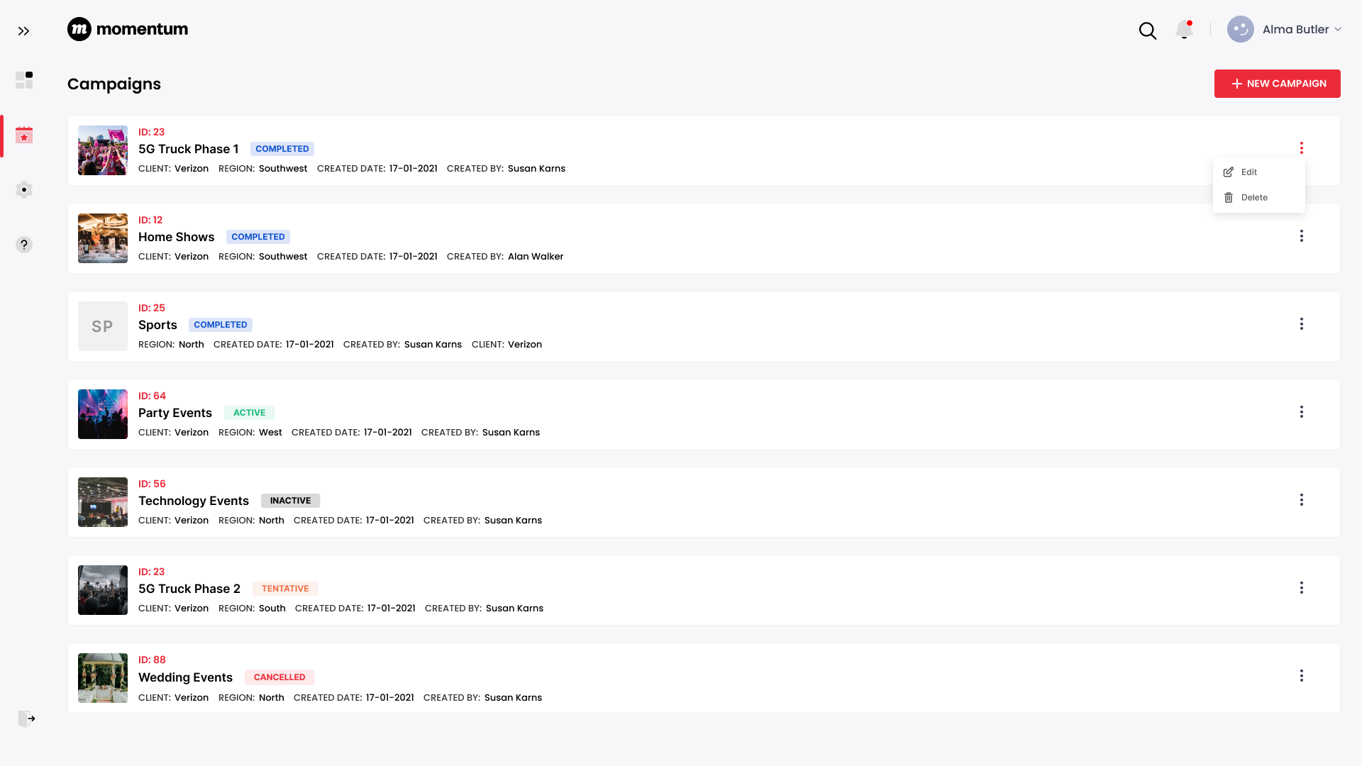
Campaigns

Slide 5
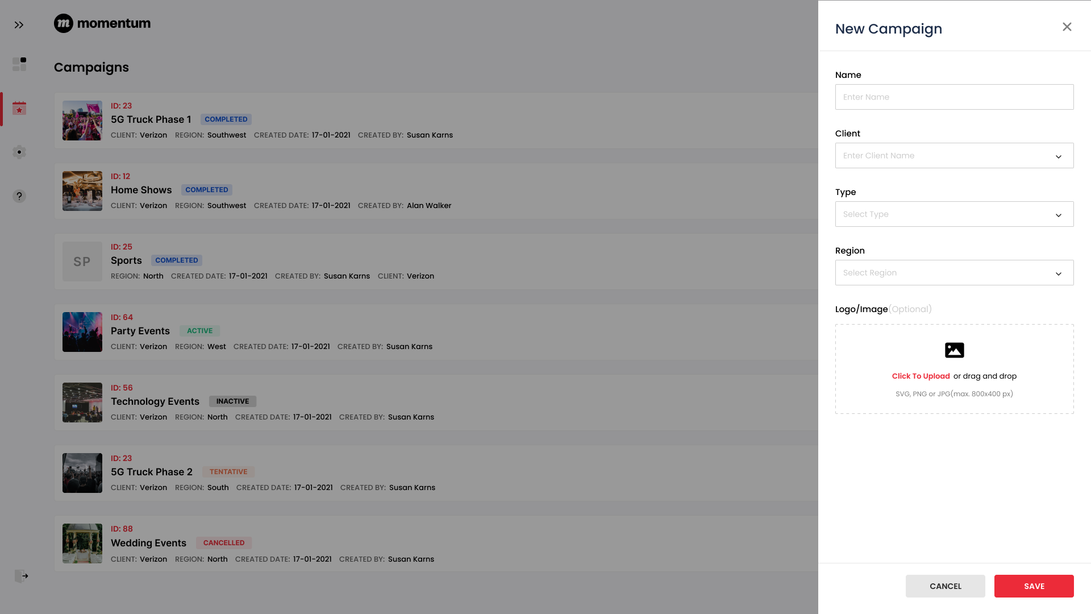
New Campaign

Slide 6
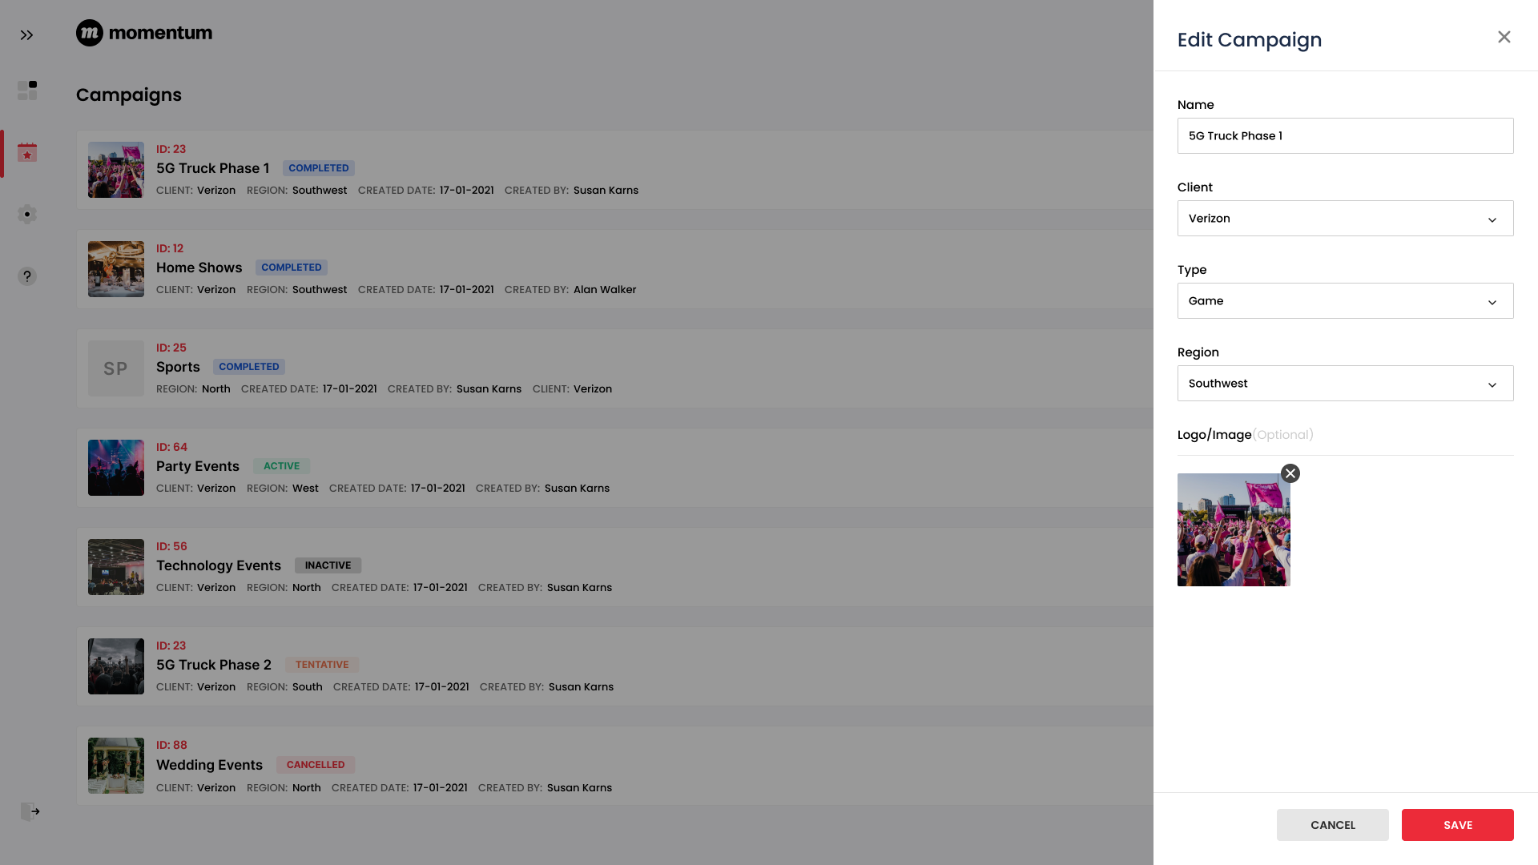
Edit Campaign

Slide 7
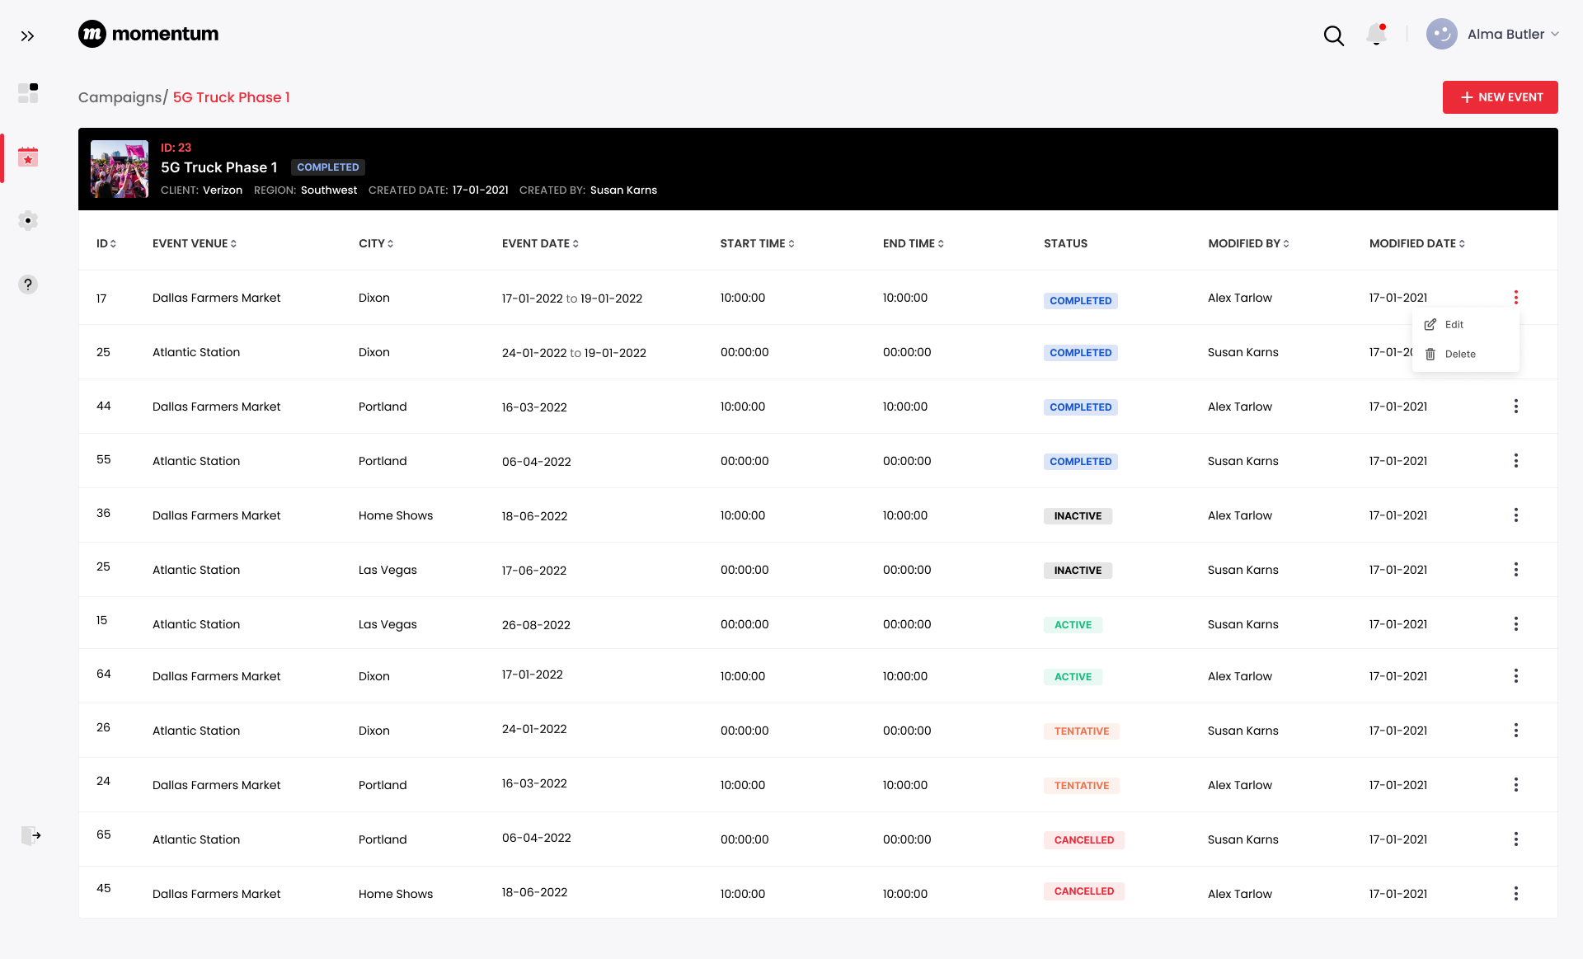
Events

Slide 8
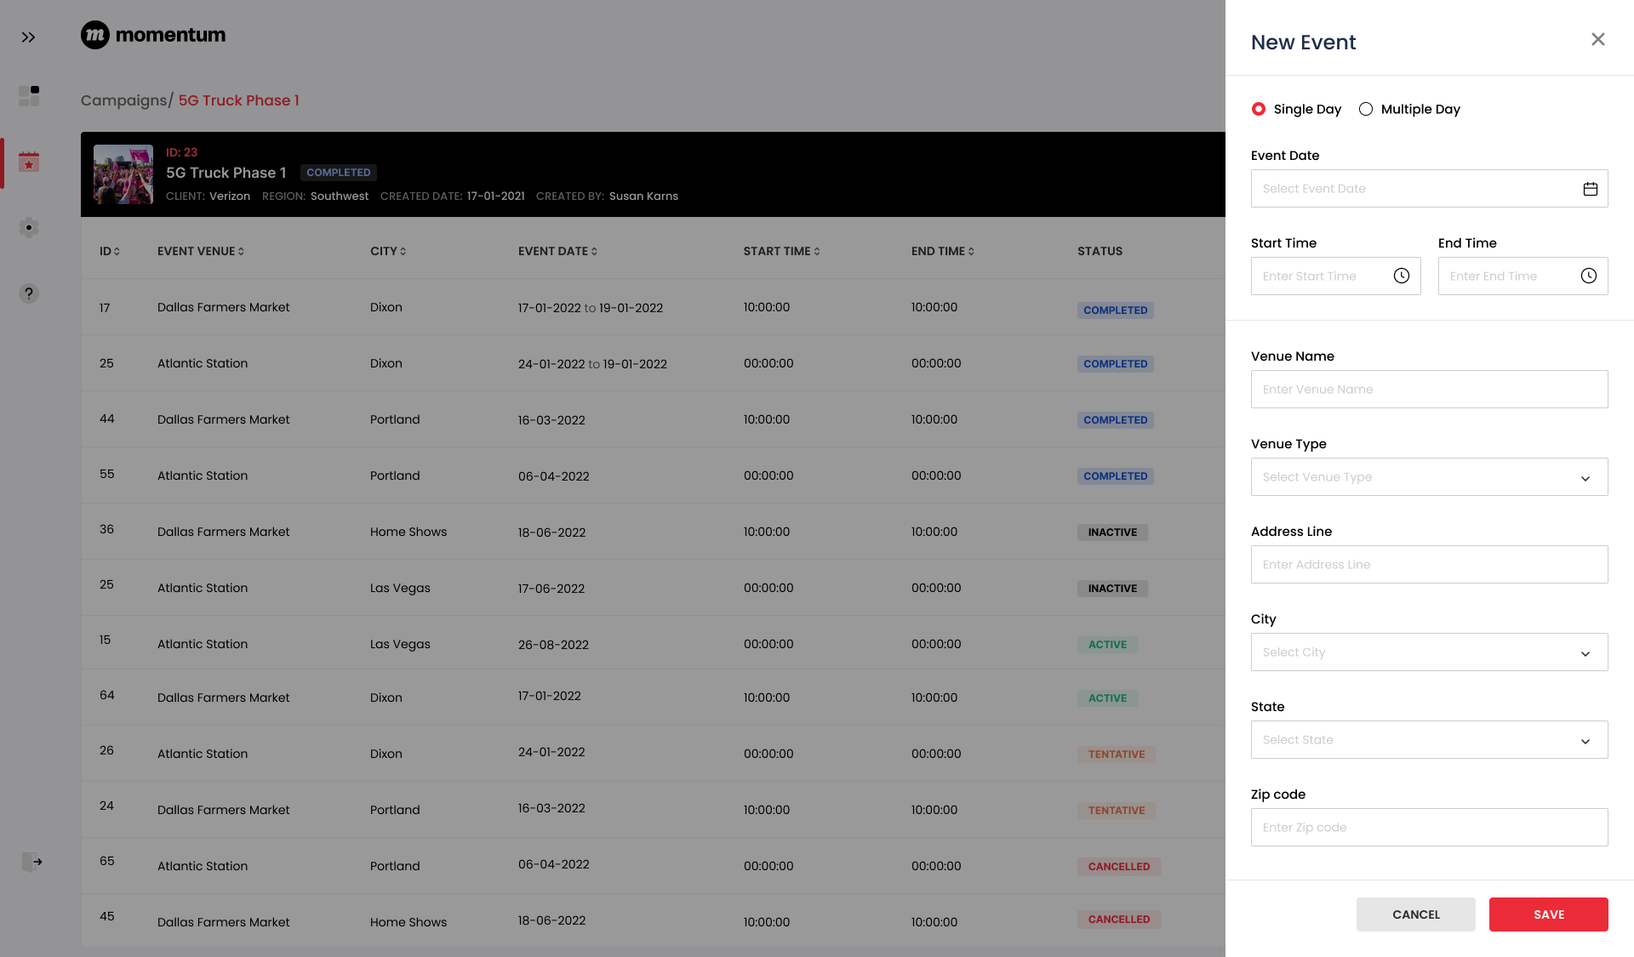
New Event

Slide 9

Create Event

Slide 10

Create Event

Slide 11
2
Brandscopic API Integration

Slide 12
Brandscopic API Integration.
Create Event:
  URL: /api/v1/events
  Method: POST
  Payload: campaign_id, start_date, end_date, start_time, end_time, place_reference(Venue), active, description, results_attributes, visit _id
  campaign_id will be managed in the UET database and will be mapped with events created in Brandscopic (No API is available in Brandscopic API docs to create a campaign)
2. List Events associated with the Campaign:
  URL: /api/v1/campaigns/:id/events
  Method: GET
  Returns an array of associated events
Get Event Results(Analytical Data):
  URL: /api/v1/events/:id/results
  Method: GET

Slide 13
Brandscopic API Integration.
Events Result data:
  Modules/Categories:
    Demographics
      Fields: Gender, Age, Ethnicity/Race
    Consumer Reach
      Fields: Impressions, Interactions, Samples
    Custom

Slide 14
3
Questions

Slide 15
Questions
Can you please confirm that in Brandscopic currently, events are being created independently and it’s not associated with Campaign?
Does Brandscopic have any API to create a Campaign?
Can you please provide access to the lower environment of Brandscopic APIs for the 1Rivet team?

